Slide 1
Drug Usage Prediction of Individuals Using Past Drug History
Ram Ayyala

Slide 2
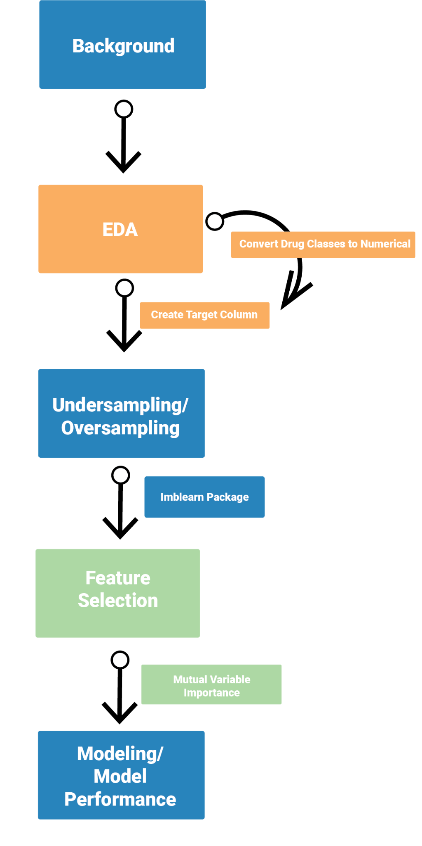
Structure

Slide 3
Background: Drug Abuse in America
In 1990, opioids were prescribed to the general public, leading to an exponential rise in the number of overdose deaths in America
In 2010, there was a rapid increase in the number of overdoses deaths involving heroin
By 2013, the overdose deaths were increasing due to the creation of synthetic opioids such as fentanyl
Since 1999, around 500,000 people have died due to this epidemic and it will probably only get worse from here
Centers for Disease Control and Prevention. (2021, March 17). Understanding the epidemic. Centers for Disease Control and Prevention. Retrieved April 20, 2022, from https://www.cdc.gov/drugoverdose/epidemic/index.html

Slide 4
Background:
Goal of this Analysis
Create a machine learning model that will predict a user’s likeliness to use drugs based on past drug history.

Slide 5
Background: Dataset
Contains 1885 responses.
Each respondent has 32 attributes
Data was collected in 2016.
Used the NEO 5-factor inventory for assessment of personality traits connected to drug abuse
Used Barratt Impulsiveness Scale
Participants were questioned on their usage of 18 legal and illegal drugs.
UCI Machine Learning Repository: Drug Consumption (quantified) data set. (n.d.). Retrieved April 20, 2022, from https://archive.ics.uci.edu/ml/datasets/Drug+consumption+%28quantified%29
Notes:
"The five factors are: N, E, O, A, and C with 12 items per domain. The five traits can be summarized as:
Neuroticism (NS) is a long-term tendency to experience negative emotions such as nervousness, tension, anxiety and depression;
Extraversion (ES) is manifested in outgoing, warm, active, assertive, talkative, cheerful, and in search of stimulation characteristics;
Openness to experience (OS) is a general appreciation for art, unusual ideas, and imaginative, creative, unconventional, and wide interests,
Agreeableness (AS) is a dimension of interpersonal relations, characterized by altruism, trust, modesty, kindness, compassion and cooperativeness;
Conscientiousness (CS) is a tendency to be organized and dependable, strong-willed, persistent, reliable, and efficient.
Barrat Impulsiveness Scale:
questionnaire designed to assess the personality/behavioral construct of impulsiveness
composed of 30 items describing common impulsive or non-impulsive (for reverse scored items) behaviors and preferences.
Items are scored on a 4-point scale:
Rarely/Never = 1
Occasionally = 2
Often = 3
Almost Always/Always = 4
Looking at
Attention
Cognitive Instability
Motor
Perseverance
Self-Control
Cognitive Complexity
Participants were questioned concerning their use of 18 legal and illegal drugs (alcohol, amphetamines, amyl nitrite, benzodiazepines, cannabis, chocolate, cocaine, caffeine, crack, ecstasy, heroin, ketamine, legal highs, LSD, methadone, magic mushrooms, nicotine and volatile substance abuse (VSA)) and one fictitious drug (Semeron) which was introduced to identify over-claimers."

Slide 6
Background:
Dataset Attributes
Demographic and Personality Attributes
ID
Age: 18-24, 25-34, 35-44, 45-54, 55-64, 65+
Gender
Education
Left before age 16, left @ 16, @ 17, @ 18, some college, prof cert, univ degree, masters, doctorate
Country
AUS, CAN, NZ, Other, IRE, UK, USA
"Ethnicity
Asian, Black, Mixed Bla/As, Mixed Whi/As, Mixed Whi/Bla, Other
Neuroticism Score
Extroversion Score
Openness to experience Score
Agreeableness Score
Conscientiousness Score
Impulsivity
Lickert scale with -3 = least impulsive, +3 = most impulsive
Sensation seeking
part of the Impulsiveness assessment, -3 < score > +3
Drug Use Attributes
Alcohol consumption
Amphetamine consumption
Amyl nitrite consumption
Benzodiazepine consumption
Caffeine consumption
Cannabis consumption
Chocolate consumption
Cocaine consumption
Crack cocaine consumption
Ecstasy consumption
Heroin consumption
Ketamine consumption
Legal highs consumption
LSD consumption
Methamphetamine consumption
Mushrooms consumption
Nicotine consumption
Drug Semeron consumption
Volatile substance abuse consumption
UCI Machine Learning Repository: Drug Consumption (quantified) data set. (n.d.). Retrieved April 20, 2022, from https://archive.ics.uci.edu/ml/datasets/Drug+consumption+%28quantified%29
Notes:
Note that the majority of the age group was 18-24 with 34%

Slide 7
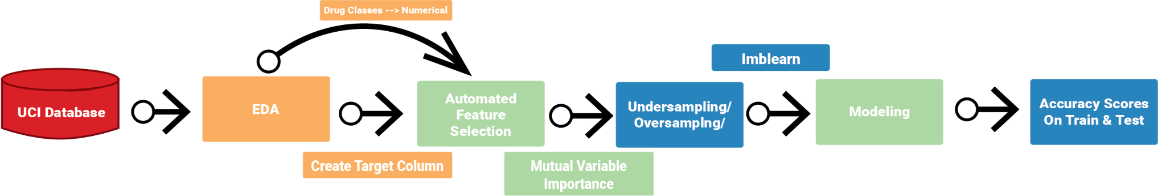
Background: Workflow
Notes:
Note that for the presentation we are talking about undersampling/oversampling before feature selection

Slide 8
EDA: Convert Drug Classes to Numerical Values
For each drug class in the dataset, the participant was asked to choose between one of the 7 classifications of when they used the drug
In order to use these values in a modeling setting, we need to convert them from categorical variables into either factor variables or numerical values, of which the latter was chosen
CL0: Never used → 0.0
CL1: Used over a decade ago → 1.0
CL2: Used in last decade → 2.0
CL3: Used in last year → 3.0
CL4: Used in last month → 4.0
CL5: Used in last week → 5.0
CL6: Used in last day → 6.0

Slide 9
EDA: Creating a Target Variable
Target Variable:
This variable contains the information from which we are trying to train our model to predict when given a dataset that doesn’t have a target variable
Within the raw dataset, there was no target variable for the model to predict an outcome for.
Based on what was recommended by the UCI Database description, a target variable, “Drug Use” was created based on the following criteria:
Binary Classification by union of the drug classes into two new classes
“Never Used”, “Used Over a Decade Ago” = “Not Likely to Use” = 0
“Used in Last Decade”, “Used in Last Year”, “Used in Last Month”, “Used in Last Week”, “Used in Last Day” = “Likely to Use” = 1

Slide 10
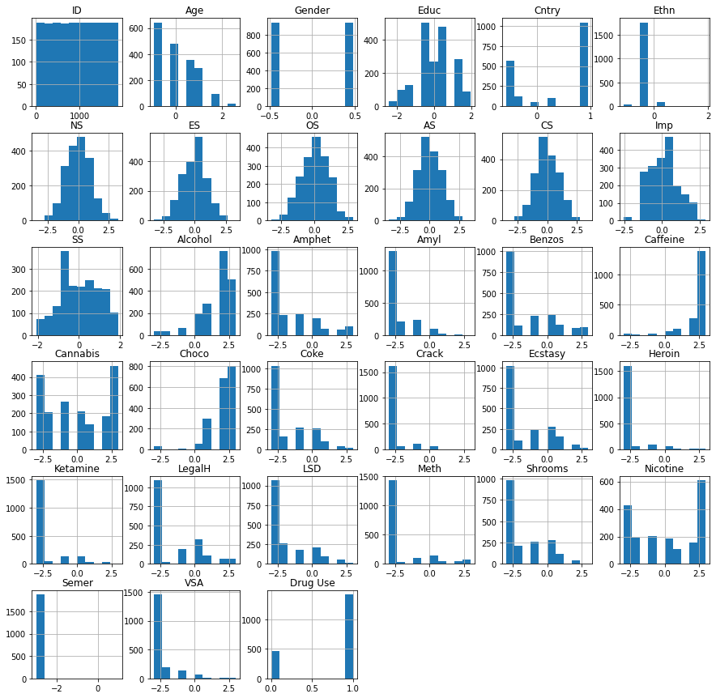
EDA: Dataset Distribution
Drug Use/Target Column is imbalanced, with a heavy skew towards “Likely to Use Category”
Need to use an undersampling or oversampling method when creating training datasets to avoid overfitting
Notes:
Overfitting is a modeling error in statistics that occurs when a function is too closely aligned to a limited set of data points. As a result, the model is useful in reference only to its initial data set, and not to any other data sets.
Model becomes not generalizable and essentially just memorizes the training data set rather than using that to predict

Slide 11
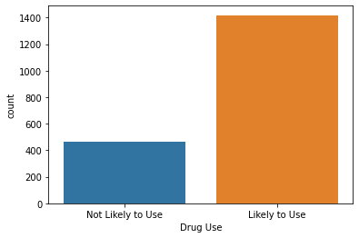
EDA: Dataset Distribution
Drug Use/Target Column is imbalanced, with a heavy skew towards “Likely to Use Category”
Need to use an undersampling or oversampling method when creating training datasets to avoid overfitting

Slide 12
Undersampling Dataset
Undersampling
Randomly removing samples from the majority class in the training data to resolve the imbalance between the two classes
In order to address the imbalance between the majority class (Likely to use drugs) and the minority class (Not Likely to use drugs)
Employ the method of undersampling to prevent the model from overfitting due to the large number of the majority class.
Before Undersampling:
Training Data contained:
1000 Majority Class Samples & 319 Minority Class Samples
After Undersampling:
Training Data contained:
319 Samples in both Majority and Minority Classes

Slide 13
Oversampling Dataset
Oversampling
Randomly duplicating samples from the minority class in the training data to resolve the imbalance between the two classes
In order to address the imbalance between the majority class (Likely to use drugs) and the minority class (Not Likely to use drugs)
Employ the method of oversampling to prevent the model from overfitting due to the large number of the majority class.
Before Oversampling:
Training Data contained:
1000 Majority Class Samples & 319 Minority Class Samples
After Oversampling:
Training Data contained:
1000 Samples in both Majority and Minority Classes

Slide 14
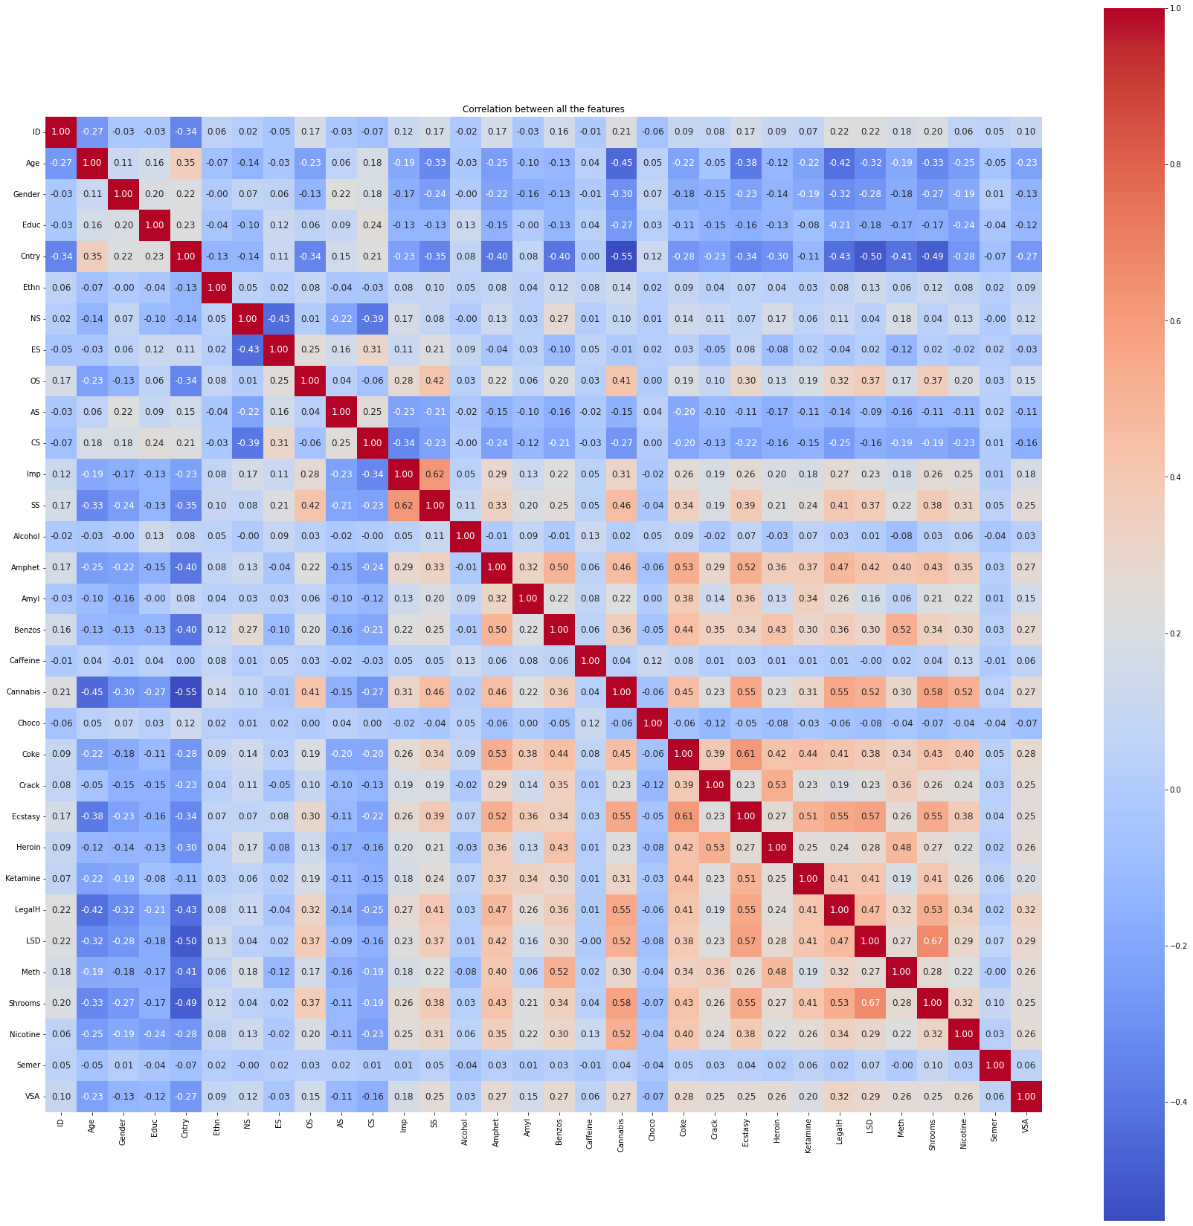
Feature Selection
the process of reducing the number of input variables when developing a predictive model
Using manual feature selection for this dataset is a bit of a hassle due to the large number of features available.
32 total features
Not every feature is necessarily useful for modeling as it may even decrease performance
To avoid manual feature selection, will use sci-kit learn’s automated feature selection method
Sklearn.feature_selection.mutual_info_classif. scikit. (n.d.). Retrieved April 21, 2022, from https://scikit-learn.org/stable/modules/generated/sklearn.feature_selection.mutual_info_classif.html
Notes:
Why?
Remove Correlated Inputs: Like linear regression, the model can overfit if you have multiple highly-correlated inputs. Consider calculating the pairwise correlations between all inputs and removing highly correlated inputs.
complexity that minimizes bias + variance = reducible error
More features = higher complexity
Multicollinearity:
the existence of such a high degree of correlation between supposedly independent variables being used to estimate a dependent variable that the contribution of each independent variable to variation in the dependent variable cannot be determined.
it undermines the statistical significance of an independent variable.
an independent variable can be predicted from another independent variable in a regression model

Slide 15
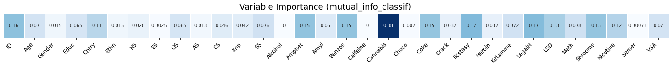
Automated Feature Selection: Mutual Importance
Mutual Importance (MI):
a non-negative value measuring the dependency between two variables
If two variables are independent of each other then, the MI score will be 0
The higher the MI score, the more dependent the target outcome is on that feature
The scores are determined using methods based on entropy estimation from K-Nearest-Neighbors (KNN) distances
Based on the scores
Cannabis is the most important feature
Highly correlated with the target variable
Need to minimize the number of features to the features deemed influential on determining the target outcome
Need to find the optimal percentage of features that work with model
Sklearn.feature_selection.mutual_info_classif. scikit. (n.d.). Retrieved April 21, 2022, from https://scikit-learn.org/stable/modules/generated/sklearn.feature_selection.mutual_info_classif.html
Notes:
KNN
simple algorithm that stores all the available cases and classifies the new data or case based on a similarity measure
K is the number of neighbors the algorithm looks at
Let’s say we have a dataset with two kinds of points — Label 1 and Label 2. Now given a new point in this dataset we want to figure out its label. The way it is done in kNN is by taking a majority vote of its k nearest neighbours. k can take any value between 1 and infinity but in most practical cases k is less than 30.
Let’s say we have two groups of points — blue-circles and orange-triangles. We want to classify the Test Point = black circle with a question mark, as either a blue circle or an orange triangle.
For K = 1 we will look at the first nearest neighbour. Since we take majority vote and there is only 1 voter we assign its label to our black test point. We can see that the test point will be classified as a blue circle for k=1.
Expanding our search radius to K=3 also keeps the result same, except that this time it is not an absolute majority, it’s 2 out of 3. Still with k=3 test point is predicted to have the class blue-circle →because the majority of points are blue.
Let’s see how k=5 and K =9 do. To look at the nearest neighbors we draw circle with test point at the centre and stop when 5 points fall inside the circle.
When we look at the 5 and subsequently at K = 9, the majority of the closest neighbors of our test point are orange-triangles. That indicates that the test point must be an orange triangle.

Slide 16
Automated Feature Selection: Selected Features (Top 50%)
ID | Age | Cntry | SS | Amphet | Amyl | Benzos | Cannabis | Coke | Ecstasy | Ketamine | LegalH | LSD | Meth | Shrooms | Nicotine
1 | 0.49788 | 0.96082 | -1.18084 | 2 | 0 | 2 | 0 | 0 | 0 | 0 | 0 | 0 | 0 | 0 | 2
2 | -0.07854 | 0.96082 | -0.21575 | 2 | 2 | 0 | 4 | 3 | 4 | 2 | 0 | 2 | 3 | 0 | 4
3 | 0.49788 | 0.96082 | 0.40148 | 0 | 0 | 0 | 3 | 0 | 0 | 0 | 0 | 0 | 0 | 1 | 0
4 | -0.95197 | 0.96082 | -1.18084 | 0 | 0 | 3 | 2 | 2 | 0 | 2 | 0 | 0 | 0 | 0 | 2
5 | 0.49788 | 0.96082 | -0.21575 | 1 | 1 | 0 | 3 | 0 | 1 | 0 | 1 | 0 | 0 | 2 | 2
... | ... | ... | ... | ... | ... | ... | ... | ... | ... | ... | ... | ... | ... | ... | ...

Slide 17
Modeling: Which Model?
There are many models to choose from, but we only need to use one
Used GridSearchCV to find the best model
Performs an exhaustive search over the parameter values for each model
Implements a fit and score method
Uses a cross validation method which will help us detect overfitting
Sklearn.model_selection.GRIDSEARCHCV. scikit. (n.d.). Retrieved April 20, 2022, from https://scikit-learn.org/stable/modules/generated/sklearn.model_selection.GridSearchCV.html
Notes:
Cross Validation
a technique for evaluating ML models by training several ML models on subsets of the available input data and evaluating them on the complementary subset of the data. Use cross-validation to detect overfitting, ie, failing to generalize a pattern.
Essentially redoing the split of the train and test dataset cv times, usually around 5-10, to ensure that it is not because of the way we split the data that the results turned out so

Slide 18
Modeling: GridSearchCV Without Undersampling/Oversampling
Without undersampling, many of the scores are very high, with the top two models, the decision tree model and random forest model, nearing 1.0, which is a clear sign of overfitting
 | Model | Best Parameters | Score
1 | decision_tree | {'criterion': 'gini', 'max_depth': 10} | 0.998485
2 | random_forest | {'n_estimators': 200} | 0.991661
0 | logistic_regression | {'C': 1} | 0.956786
6 | QDA | {} | 0.940849
4 | LDA | {} | 0.919613
3 | guassian bayes naive | {} | 0.912787
7 | RIDGE | {} | 0.501211
5 | LASSO | {} | 0.464053
Notes:
Decision Tree Classifier
uses a set of rules to make decisions, similarly to how humans make decisions.
create a training model that can use to predict the class or value of the target variable by learning simple decision rules inferred from prior data(training data)
for predicting a class label for a record we start from the root of the tree. We compare the values of the root attribute with the record’s attribute. On the basis of comparison, we follow the branch corresponding to that value and jump to the next node.
Decision trees normally suffer from the problem of overfitting if it’s allowed to grow without any control.
A single decision tree is faster in computation.
When a data set with features is taken as input by a decision tree it will formulate some set of rules to do prediction.
Random Forest
builds decision trees on different samples and takes their majority vote for classification and average in case of regression.
Random forests are created from subsets of data and the final output is based on average or majority ranking and hence the problem of overfitting is taken care of.
It is comparatively slower.
Random forest randomly selects observations, builds a decision tree and the average result is taken. It doesn’t use any set of formulas.
Logistic Regression
Next slide
QDA
Next slide
LDA
used here to reduce the number of features to a more manageable number before the process of classification
use Bayes' Theorem to estimate probabilities. They make predictions based upon the probability that a new input dataset belongs to each class. The class which has the highest probability is considered the output class and then the LDA makes a prediction.
Gaussian Bayes Naive
Gaussian Naive Bayes is a variant of Naive Bayes that follows Gaussian normal distribution and supports continuous data.
Bayes theorem → calculate conditional probability
These classifiers assume that the value of a particular feature is independent of the value of any other feature. In a supervised learning situation, Naive Bayes Classifiers are trained very efficiently. Naive Bayed classifiers need a small training data to estimate the parameters needed for classification. Naive Bayes Classifiers have simple design and implementation and they can applied to many real life situations.
an assumption often taken is that the continuous values associated with each class are distributed according to a normal (or Gaussian) distribution.
Ridge Regression
model tuning method that is used to analyse any data that suffers from multicollinearity. This method performs L2 regularization. When the issue of multicollinearity occurs, least-squares are unbiased, and variances are large, this results in predicted values being far away from the actual values.
LASSO
lasso (least absolute shrinkage and selection operator; also Lasso or LASSO) is a regression analysis method that performs both variable selection and regularization in order to enhance the prediction accuracy and interpretability of the resulting statistical model.

Slide 19
Modeling: GridSearchCV With Undersampling
With the undersampled training data, the scores virtually stay the same except that the Logistic Regression model’s score increase while the QDA model’s score decreased
These scores are more accurate due to using undersampling
When choosing a model from this table, it would be best to choose the model that is not nearing 1.0 to avoid overfitting
Which is why, the Quadratic Discriminant Analysis (QDA) or Linear Regression Model are the best choice
 | Model | Best Parameters | Score
1 | decision_tree | {'criterion': 'gini', 'max_depth': 5} | 0.9953
2 | random_forest | {'n_estimators': 100} | 0.992175
0 | logistic_regression | {'C': 10} | 0.970189
6 | QDA | {} | 0.935765
3 | guassian bayes naive | {} | 0.927904
4 | LDA | {} | 0.902879
7 | RIDGE | {} | 0.125601
5 | LASSO | {} | 0.121776
Notes:
Decision Tree Classifier
uses a set of rules to make decisions, similarly to how humans make decisions.
create a training model that can use to predict the class or value of the target variable by learning simple decision rules inferred from prior data(training data)
for predicting a class label for a record we start from the root of the tree. We compare the values of the root attribute with the record’s attribute. On the basis of comparison, we follow the branch corresponding to that value and jump to the next node.
Decision trees normally suffer from the problem of overfitting if it’s allowed to grow without any control.
A single decision tree is faster in computation.
When a data set with features is taken as input by a decision tree it will formulate some set of rules to do prediction.
Random Forest
builds decision trees on different samples and takes their majority vote for classification and average in case of regression.
Random forests are created from subsets of data and the final output is based on average or majority ranking and hence the problem of overfitting is taken care of.
It is comparatively slower.
Random forest randomly selects observations, builds a decision tree and the average result is taken. It doesn’t use any set of formulas.
Logistic Regression
Next slide
QDA
Next slide
LDA
used here to reduce the number of features to a more manageable number before the process of classification
use Bayes' Theorem to estimate probabilities. They make predictions based upon the probability that a new input dataset belongs to each class. The class which has the highest probability is considered the output class and then the LDA makes a prediction.
Gaussian Bayes Naive
Gaussian Naive Bayes is a variant of Naive Bayes that follows Gaussian normal distribution and supports continuous data.
Bayes theorem → calculate conditional probability
These classifiers assume that the value of a particular feature is independent of the value of any other feature. In a supervised learning situation, Naive Bayes Classifiers are trained very efficiently. Naive Bayed classifiers need a small training data to estimate the parameters needed for classification. Naive Bayes Classifiers have simple design and implementation and they can applied to many real life situations.
an assumption often taken is that the continuous values associated with each class are distributed according to a normal (or Gaussian) distribution.
Ridge Regression
model tuning method that is used to analyse any data that suffers from multicollinearity. This method performs L2 regularization. When the issue of multicollinearity occurs, least-squares are unbiased, and variances are large, this results in predicted values being far away from the actual values.
LASSO

Slide 20
Modeling: GridSearchCV With Oversampling
Like the undersampled scores, the oversampled scores virtually stay the same except that the Logistic Regression model’s score increase while the QDA model’s score decreased
These scores are more accurate due to using oversampling
When choosing a model from this table, it would be best to choose the model that is not nearing 1.0 to avoid overfitting
Which is why, the Quadratic Discriminant Analysis (QDA) or Linear Regression Model are the best choice
 | Model | Best Parameters | Score
1 | decision_tree | {'criterion': 'gini', 'max_depth': 10} | 0.999
2 | random_forest | {'n_estimators': 15} | 0.9965
0 | logistic_regression | {'C': 5} | 0.9685
6 | QDA | {} | 0.938
3 | guassian bayes naive | {} | 0.92
4 | LDA | {} | 0.9025
7 | RIDGE | {} | 0.351752
5 | LASSO | {} | 0.325159
Notes:
Decision Tree Classifier
uses a set of rules to make decisions, similarly to how humans make decisions.
create a training model that can use to predict the class or value of the target variable by learning simple decision rules inferred from prior data(training data)
for predicting a class label for a record we start from the root of the tree. We compare the values of the root attribute with the record’s attribute. On the basis of comparison, we follow the branch corresponding to that value and jump to the next node.
Decision trees normally suffer from the problem of overfitting if it’s allowed to grow without any control.
A single decision tree is faster in computation.
When a data set with features is taken as input by a decision tree it will formulate some set of rules to do prediction.
Random Forest
builds decision trees on different samples and takes their majority vote for classification and average in case of regression.
Random forests are created from subsets of data and the final output is based on average or majority ranking and hence the problem of overfitting is taken care of.
It is comparatively slower.
Random forest randomly selects observations, builds a decision tree and the average result is taken. It doesn’t use any set of formulas.
Logistic Regression
Next slide
QDA
Next slide
LDA
used here to reduce the number of features to a more manageable number before the process of classification
use Bayes' Theorem to estimate probabilities. They make predictions based upon the probability that a new input dataset belongs to each class. The class which has the highest probability is considered the output class and then the LDA makes a prediction.
Gaussian Bayes Naive
Gaussian Naive Bayes is a variant of Naive Bayes that follows Gaussian normal distribution and supports continuous data.
Bayes theorem → calculate conditional probability
These classifiers assume that the value of a particular feature is independent of the value of any other feature. In a supervised learning situation, Naive Bayes Classifiers are trained very efficiently. Naive Bayed classifiers need a small training data to estimate the parameters needed for classification. Naive Bayes Classifiers have simple design and implementation and they can applied to many real life situations.
an assumption often taken is that the continuous values associated with each class are distributed according to a normal (or Gaussian) distribution.
Ridge Regression
model tuning method that is used to analyse any data that suffers from multicollinearity. This method performs L2 regularization. When the issue of multicollinearity occurs, least-squares are unbiased, and variances are large, this results in predicted values being far away from the actual values.
LASSO

Slide 21
What is Logistic Regression
Most Commonly Used Classifier
Binary Classification Setting
Comes up with a classification rule based on training data to classify new observations
Discriminative Model
Meaning it does not tell you the distribution of x
Can model non-normal features better than LDA/QDA
Linear Decision Boundary
Fits Data using Maximum Likelihood
James, G., Witten, D., Hastie, T., & Tibshirani, R. (n.d.). An introduction to statistical learning: With applications in R.
Notes:
The best coefficients would result in a model that would predict a value very close to 1 (e.g. male) for the default class and a value very close to 0 (e.g. female) for the other class. The intuition for maximum-likelihood for logistic regression is that a search procedure seeks values for the coefficients (Beta values) that minimize the error in the probabilities predicted by the model to those in the data (e.g. probability of 1 if the data is the primary class).
minimization algorithm is used to optimize the best values for the coefficients for your training data

Slide 22
What is Quadratic Discriminant Analysis
Extension of Linear Discriminant Analysis (LDA)
Does not assume variances and covariances of the data are the same in the two classes
Assumes features to be multivariate normally distributed
Very Flexible model due to less assumptions made, unlike LDA
Quadratic Decision Boundary
James, G., Witten, D., Hastie, T., & Tibshirani, R. (n.d.). An introduction to statistical learning: With applications in R.
Notes:
QDA
Extension of LDA
LDA
used here to reduce the number of features to a more manageable number before the process of classification
use Bayes' Theorem to estimate probabilities. They make predictions based upon the probability that a new input dataset belongs to each class. The class which has the highest probability is considered the output class and then the LDA makes a prediction.
Gaussian Bayes Naive
Gaussian Naive Bayes is a variant of Naive Bayes that follows Gaussian normal distribution and supports continuous data.
Bayes theorem → calculate conditional probability
These classifiers assume that the value of a particular feature is independent of the value of any other feature. In a supervised learning situation, Naive Bayes Classifiers are trained very efficiently. Naive Bayed classifiers need a small training data to estimate the parameters needed for classification. Naive Bayes Classifiers have simple design and implementation and they can applied to many real life situations.
an assumption often taken is that the continuous values associated with each class are distributed according to a normal (or Gaussian) distribution.

Slide 23
Model Performance: QDA or Logistic Regression?
Cross Validation Scores (cv=5):
Model | Sampling Method | Average Accuracy
QDA | Oversampling | 94%
QDA | Undersampling | 94%
Logistic Regression | Oversampling | 97%
Logistic Regression | Undersampling | 97%
From the cross validation scores, the Logistic Regression Model has the best average accuracy
However, both average accuracy scores are equivalent for both sampling methods for the Logistic Regression Model

Slide 24
Model Performance: Oversampling or Undersampling
Oversampling
Higher Test Score
Better Generalizable Model
Undersampling
Lower Test Score
Higher Training Score by very little
Not as generalizable as the oversampled model
Oversampling Model is the best model
Model | Sampling Method | Training Score | Test Score
Logistic Regression | Oversampling | 0.9815 | 0.9628975265
Logistic Regression | Undersampling | 0.9827586207 | 0.9487632509

Slide 25
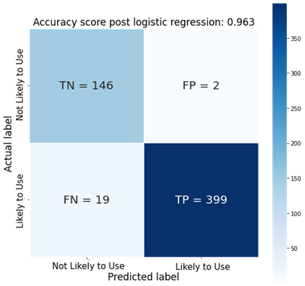
Model Performance: Logistic Regression
 | Precision | Recall | F1-Score | Support
 | 0.88 | 0.99 | 0.93 | 148
 | 1 | 0.95 | 0.97 | 418
Accuracy |  |  | 0.96 | 566
Macro Average | 0.94 | 0.97 | 0.95 | 566
Weighted Average | 0.97 | 0.96 | 0.96 | 566
Notes:
macro average (averaging the unweighted mean per label), weighted average (averaging the support-weighted mean per label), and sample average (only for multilabel classification). Micro average (averaging the total true positives, false negatives and false positives) is only shown for multi-label or multi-class with a subset of classes, because it corresponds to accuracy otherwise and would be the same for all metrics. See also precision_recall_fscore_support for more details on averages.
Note that in binary classification, recall of the positive class is also known as “sensitivity”; recall of the negative class is “specificity”.
The precision is the ratio tp / (tp + fp) where tp is the number of true positives and fp the number of false positives. The precision is intuitively the ability of the classifier not to label as positive a sample that is negative.
The recall is the ratio tp / (tp + fn) where tp is the number of true positives and fn the number of false negatives. The recall is intuitively the ability of the classifier to find all the positive samples.
The F-beta score can be interpreted as a weighted harmonic mean of the precision and recall, where an F-beta score reaches its best value at 1 and worst score at 0.
The F-beta score weights recall more than precision by a factor of beta. beta == 1.0 means recall and precision are equally important.
The support is the number of occurrences of each class in y_true.

Slide 26
Conclusion
Logistic Regression seems to be the best model in terms of performance to predict a person’s likelihood of using drugs
Use an Oversampling method instead of an Undersampling method leads to better generalization of the model for prediction purposes

Slide 27
Future Directions
Prediction Dataset
No dataset was available that contained all of the same columns as the dataset used in this analysis
If I were to use one of these available datasets, would need to impute many of the columns and that still probably lead to poor results
Gather new data using the same format to test model on to see if prediction is as good as was the model performance scores are showing
Narrow Model to a Singular Drug
See if a specific drug, for example cannabis since that had the highest MI, could be a sole predictor of drug use
Personality Columns
The Automated feature selection removed most of the personality responses, so would be interesting to figure out a way if those values could be used
How could it be applied in an industry setting?
Potentially to speed up screening of patients for drug use
Notes:
How would this model be useful for a company?

